Slide 1
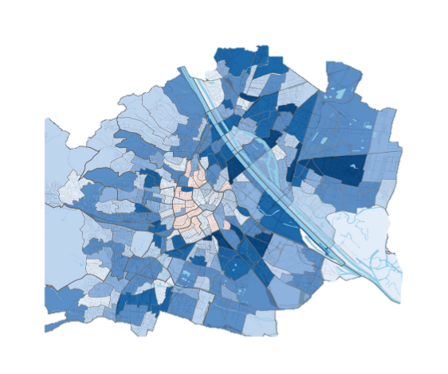
Background
Plenary
Vienna’s population
Population expected to hit 2 million mark by 2028
Vienna’s GHG emissions
Population grows at faster rate than reduction rate of GHG emissions
Urban population in Austria
Around 58.52%
+12% by 2080
Identification of critical sectors in Vienna’s metabolic system
Improves the consumption efficiency and promotes the efficient and sustainable development

Slide 2
Research Questions
Plenary
How to integrate the use of emergy input–output table and ecological network analysis to construct Vienna’s metabolic network model?
How to determine the status of the system components using system-level analyses (flow and contribution analyses)?
How to identify the critical components responsible for emergy consumption using pairwise control and utility analyses?
How indirect effects of internal metabolic processes affect the hierarchy and role of each component in Vienna’s metabolic system?
What corrective measures targeted at each critical sector of the Vienna’s metabolic system should be applied to improve the overall efficiency and sustainability of emergy consumption?

Slide 3
Data
Plenary
Network model of Vienna metabolic system
The model of builds on balanced Vienna’s emergy input-output table.
Original table was balanced using the Generalized RAS (GRAS) method to conform to steady state rule.
We used an approximate data on storage values of sectors since Storage Analysis was out of scope of our study

Slide 4
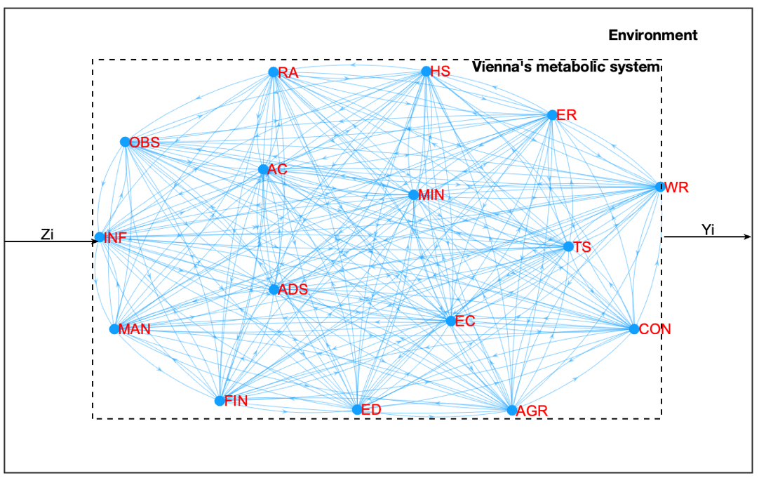
Ecological network model of Vienna’s metabolic system
Plenary
Zi and Yi represent inputs from and to the external environment of the metabolic system, respectively.
‘Environment’ includes the natural environment within Vienna’s boundary and outside of the region
Sector | Sector names
AGR | Agriculture, forestry, and fishing
MIN | Mining and quarrying
MAN | Manufacturing
EC | Electricity, gas, water supply, sewerage, waste, and remediation services
CON | Construction
WR | Wholesale and retail trade, repair of motor vehicles
TS | Transportation and storage
AC | Accommodation and food service activities
INF | Information and communication
FIN | Financial and insurance activities
RA | Real estate activities
OBS | Professional, scientific, technical, administrative, and support service activities
ADS | Public administration and defence, compulsory social security
ED | Education
HS | Human health and social work activities
ER | Arts, entertainment, and recreation, repair of household goods and other service

Slide 5
Ecological Network Analysis
Plenary
ENA
Flow Analysis
Estimates flows and their transfer efficiencies along all possible path lengths in urban
metabolic system
Contribution Analysis
Measures the total influence of each component on other components in the system, and vice versa
Control Analysis
Measures dependence and control between each pair of components
Utility Analysis
Assesses benefits and costs between each pair of components in the system

Slide 6
Plenary
Implications and Conclusions: System-level status
Consumers (downstream)
Strong pulling sectors (ADS, and HS )
Producers (AGR and MIN)
Suppliers (AGR and MIN ) do not have enough indirect support to drive development in downstream industries
Reliance on imported products (TS and EC)
No importance in the system (WR and CON)

Slide 7
Plenary
Implications and Conclusions: Pairwise level
EC
Competition between EC and AGR sectors contributed to the unstable state of AGR.
WR
Responsible for the low pulling ability of MIN sector
AGR
Hindered MIN and EC’s capacity to deliver indirectly.
MIN

Slide 8
Plenary
Implications and Conclusions: Limitations
Limitations
The application Ecological Network Analysis restricted to the determined systems of equations
The pairwise direct (DN) and indirect control (IN) matrices need to be rescaled to avoid negatives and values of indirect control being larger than integral values.

Slide 9
Implications and Conclusions: Future Recommendations
Plenary
Adjustments in production structures of AGR and MIN sectors are necessary to reduce direct consumption of these sectors and to improve their indirect receiving capacities
The pulling force weights of AGR and MIN sectors and their indirect delivery abilities should be increased and decreased, respectively, to effectively receive and transfer emergy.
Removal of direct pathways between AGR and EC sectors and shift from competition exploitation relationship between AGR and all other sectors will lead to mutualistic relations

Slide 10
Implications and Conclusions: Future Recommendations
Plenary
Establishment of eco-industrial parks should improve the overall level of mutualism and synergism
Many sectors require financial investment (FIN, RA, INF , OBS, WR and CON) as well as reduction of number of indirect paths (CON,RA, ER, AC) to drive development of AGR and MIN sectors
The production structure of sectors (ADS, TS, EC, MAN and WR) should be improved to increase their indirect deliver ability

